Slide 1

Refrigerator Market Data Analysis
A Comprehensive Data-Driven Study

Slide 2
About group
Alladi Vijay Kumar: Data Analytics (batch 495)
Education : MBA graduate
LinkedIn: https://www.linkedin.com/in/vijay-rao-alladi-93691b304?utm_source=share&utm_campaign=share_via&utm_content=profile&utm_medium=android_app
Shaik Shoyab Raza: Data Analytics (batch 495)
Education : B-tech CSE(data science)
LinkedIn : https://www.linkedin.com/in/shoyab-raza-raza-648a86280?utm_source=share&utm_campaign=share_via&utm_content=profile&utm_medium=android_app
Abhinav Anand: Data Analytics (495)
Education : Bachelor in Computer Application (BCA)
LinkedIn :https://www.linkedin.com/in/abhinav-anand-913b78342?utm_source=share&utm_campaign=share_via&utm_content=profile&utm_medium=android_app

Slide 3
Introduction
Analyzing the refrigerator segment reveals a highly competitive landscape driven by e-commerce expansion and consumer demand for high-performance, energy-efficient appliances from Flipkart .

Slide 4






Presentation Agenda
Foundations
Analysis
Summary
Methodology and rigorous data cleaning processes employed to ensure accuracy.
Detailed insights from Univariate, Bivariate, and Multivariate visualizations.
Strategic conclusions based on discovered market correlations and trends.

Slide 5


Problem Statement
Market Complexity
Pricing Strategy
With thousands of models, consumers face "choice paralysis." Identifying the specific features that drive value is critical for market positioning.
Retailers need to understand the correlation between star ratings, door types, and price premiums to optimize inventory.

Slide 6
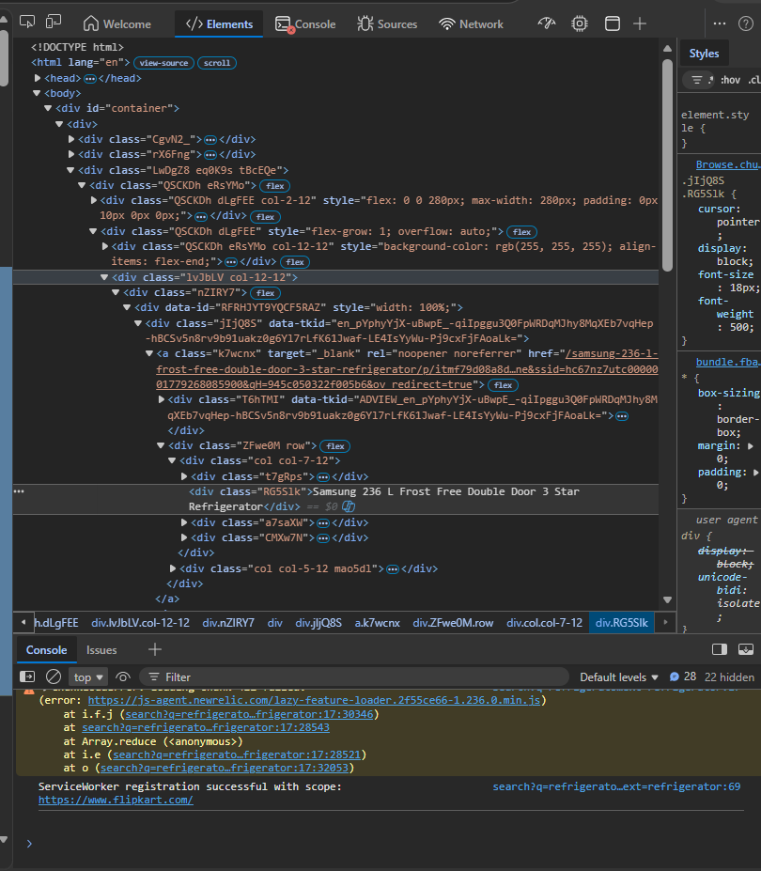
Web Scraping: Refrigerator Data Project
Flipkart was selected as the target e-commerce data source for retrieving comprehensive refrigerator listings.
Used browser developer tools (Inspect Element) to locate parent container cards (div class ZFwe0M row) and child element tags.
Passed a custom User-Agent spoofed header into HTTP requests to bypass security restrictions and avoid 403 Forbidden errors.
Scaled extraction automatically using a dynamic multi-page iteration loop to capture data continuously across 105 pages.
Utilized BeautifulSoup and Requests to parse and target specific attributes like Product Name, Current Price, Original Price, Ratings, and Reviews.
Built dynamic structural error handling via NumPy inline logic (np.nan) to keep the script running smoothly if features were missing on a card.
Structured all harvested vectors into a structured Pandas DataFrame and serialized the dataset directly into a permanent Refrigerator.csv file.

Slide 7
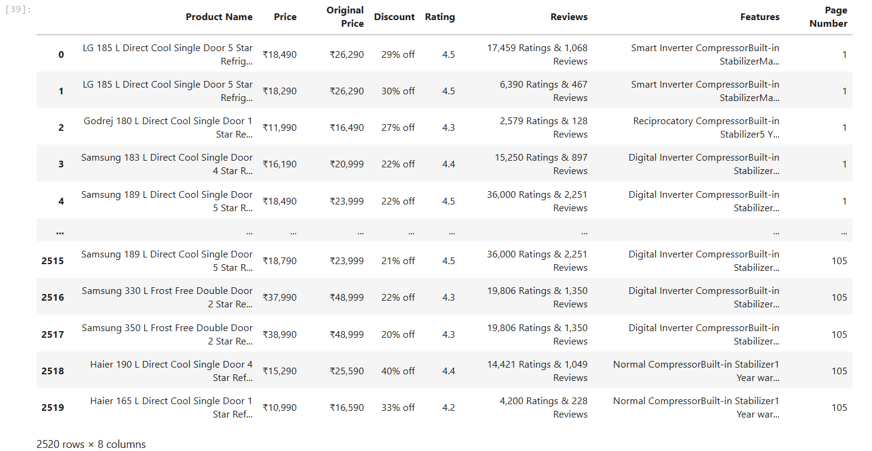
Dataset :

Slide 8
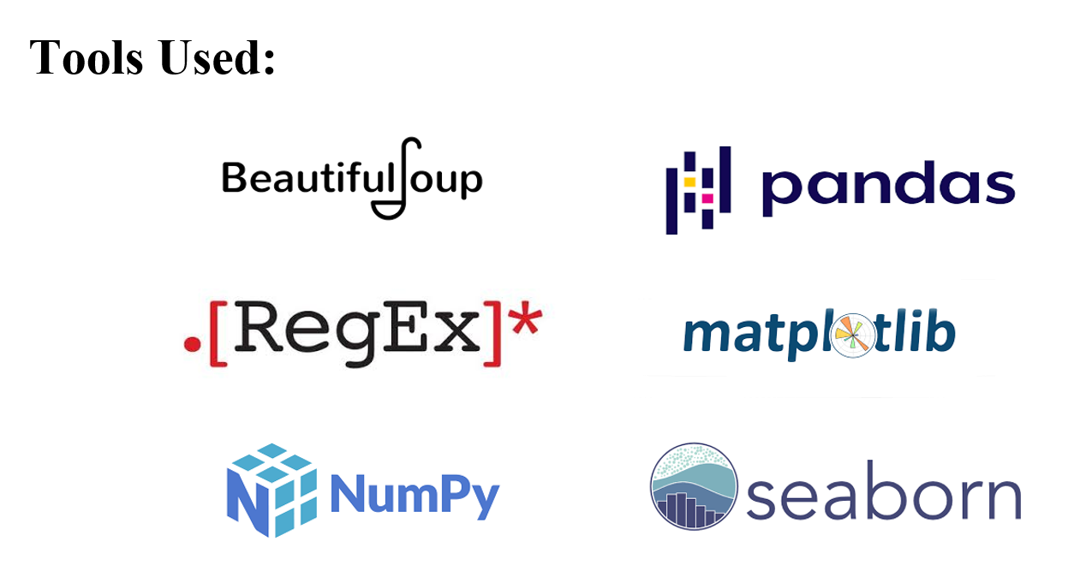

Slide 9
Data Analysis Process
Ingestion: Importing structured Refrigerator datasets from Python/Pandas.
Cleaning: Handling null values and stripping duplicates via regular expressions.
Extraction: Using Regex to parse features like Brand, Capacity, and Ratings.
Analysis: Implementing Seaborn and Matplotlib for multi-dimensional EDA.

Slide 10
Dataset Attributes Summary
Metric Type | Feature Description | Status
Total Records | Initial 2520 entries from major e-commerce platforms. | Cleaned
Unique Brands | Categorized into 27 distinct market players. | Encoded
Pricing Data | Converted from formatted strings to numerical values. | Calculated
Star Rating | Energy efficiency ratings extracted from product titles. | Extracted

Slide 11

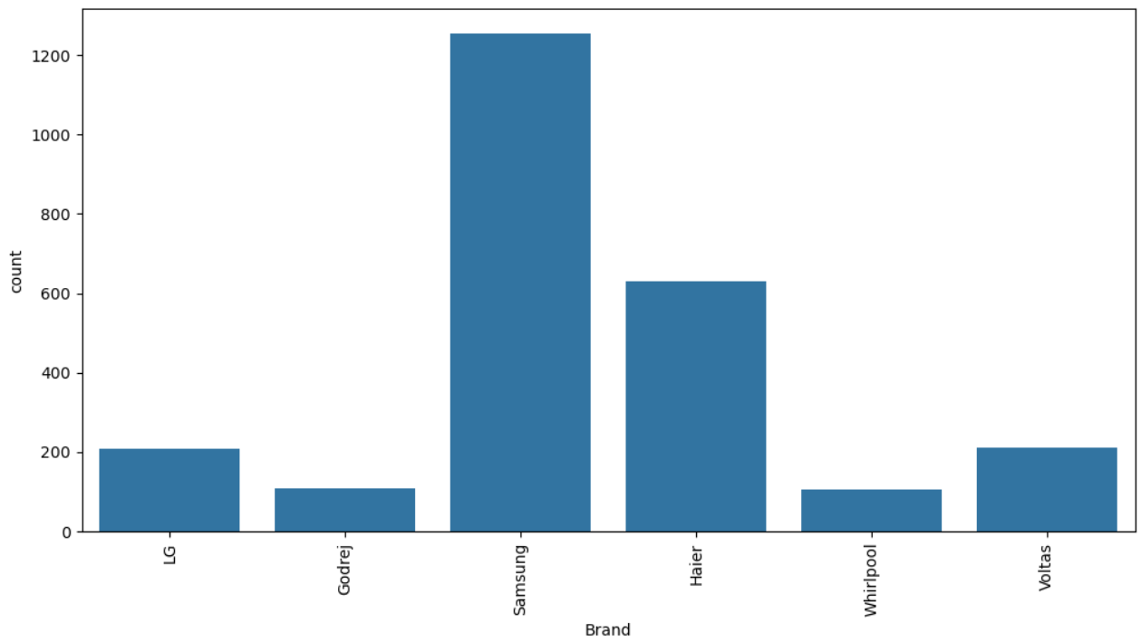
Univariate: Brand Distribution
Market Share Concentration:
"The refrigerator segment exhibits a high degree of market concentration, with Samsung and Haier collectively commanding the largest share of listings, reflecting their extensive manufacturing and distribution networks."

Slide 12
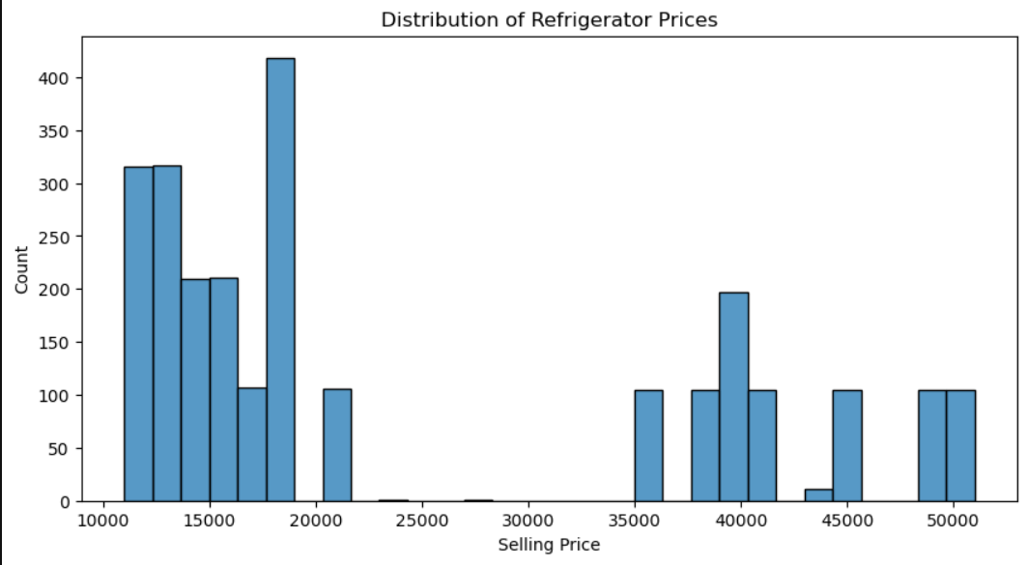
Univariate: Price Distribution
Skewed Market Trends
The distribution of selling prices is positively skewed (right-skewed), meaning most refrigerators are clustered at lower price points.

Slide 13
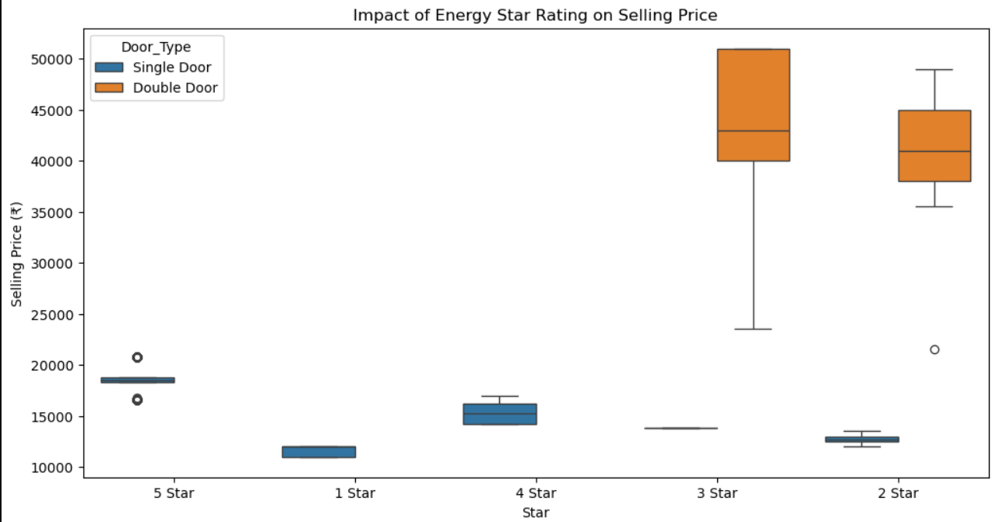
Bivariate: Star Rating vs Price
The Efficiency Premium
Bivariate analysis shows a clear upward trend in price as star ratings increase. High-efficiency 4-star models command a substantial price premium.
This suggests that manufacturers position energy efficiency as a luxury feature, targeting environmentally conscious, high-income buyers.

Slide 14
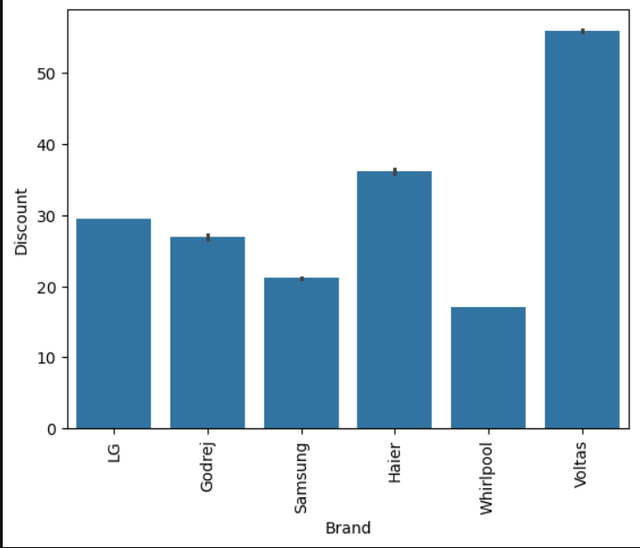
Bivariate: Price by Brand Category
Average Price Analysis
When comparing brands by their average selling price, we see distinct positioning. Samsung and Whirlpool compete heavily in the mid-range and smart fridge segments.
Budget tiers are populated by brands aiming for mass-market adoption, where price sensitivity is highest.

Slide 15
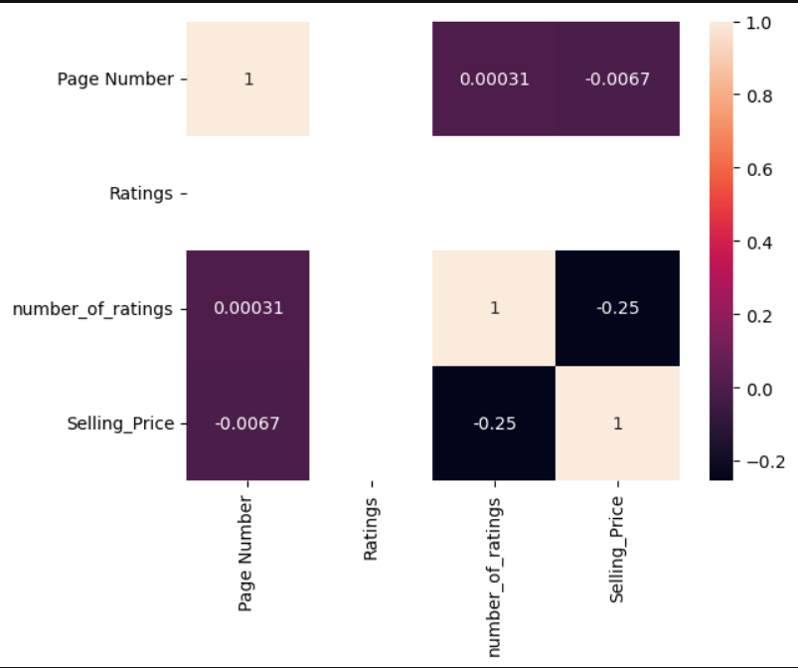
Multivariate: Correlation Matrix
Feature Relationships
The heatmap reveals strong positive correlations between capacity and selling price, as well as star ratings and price.
Interestingly, 'number of ratings' shows a moderate correlation with higher-priced models, indicating more consumer interaction in the premium segment.

Slide 16
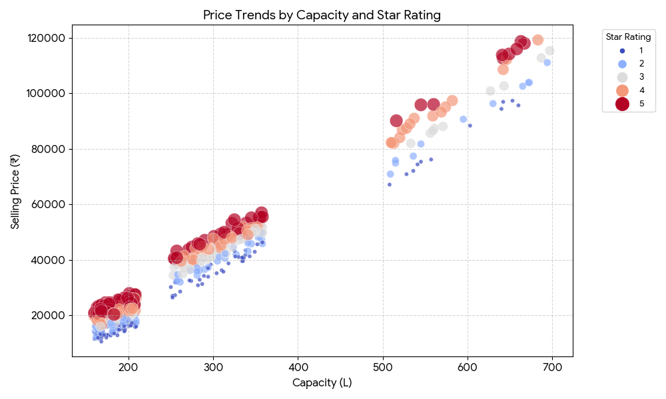
Complex Price Interactions
Brand Positioning by Door Type
Premium brands (Samsung and LG) maintain a higher price floor across all door types compared to budget-focused brands, indicating strong brand equity in the premium segments.

Slide 17






Key Strategic Market Insights
Brand Equity
Green Premium
Premium Shift
LG and Samsung retain the highest consumer trust as evidenced by listing volume and ratings.
Energy efficiency is the primary factor driving price inflation in the refrigerator market.
Consumer shift towards double-door and side-by-side units is accelerating in urban markets.

Slide 18
Final Conclusions
The data supports a market strategy focusing on 5-star energy-efficient models. Despite higher upfront costs, these units drive significant revenue and consumer engagement across e-commerce platforms.

Slide 19

Questions?
Thank you for your attention.
Market Analysis Lead: Refrigerator Insights

Slide 20

THANK YOU

